Slide 1













CREDIT EDA CASE STUDY

Slide 2










Problem Statement
Identifying patterns which indicate if a client has difficulty paying their installments which may be used for taking actions such as denying the loan, reducing the amount of loan, lending (to risky applicants) at a higher interest rate, etc.
Understand the driving factors (or driver variables) behind loan default, i.e. the variables which are strong indicators of default. The company can utilize this knowledge for its portfolio and risk assessment.

Slide 3
Analysis Approach – Part 1
Data Understanding and Exploring
Importing libraries and loading data files
Data inspection
Data Cleaning and manipulations
Data Cleaning
Exploring Data types and negative value
Imputing null values
Checking Outliers
Binning of variables

Slide 4
Analysis Approach
Data Analysis
Imbalance check in Variable Target
Univariate analysis of Categorical and numeric variables
Segmented univariate Analysis
Bivariate Analysis
Multivariate Analysis
Correlation
- Creating .csv file of analyzed app_data as new_data.csv. This file will be accessed in another
jupyter file for further analysis

Slide 5
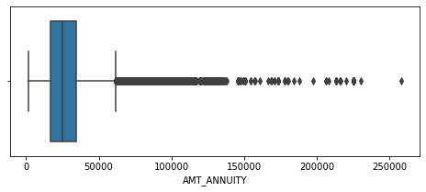
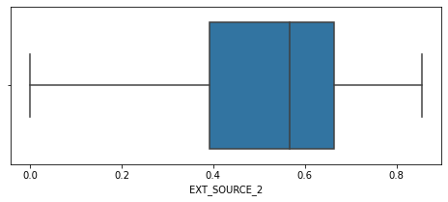
Imputation of missing values
1. VARIABLE: AMT_ANNUITY
Since AMT_ANNUITY is a continuous variable, we check for outliers using the given BOX PLOT.
As we can see from the plot there are outliers present for "AMT_ANNUITY". Hence the null values in the column can be imputed using the median of the column.
2. VARIABLE: EXT_SOURCE_2
Since EXT_SOURCE_2 is a continuous variable, we check
for outliers using the given BOX PLOT.
As we can see from the plot there are no outliers present for " EXT_SOURCE_2 ". Hence the null values in the column can be imputed using the mean of the column.

Slide 6
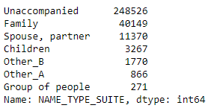
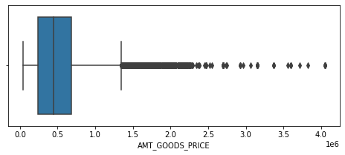
3. VARIABLE: NAME_TYPE_SUITE
Since NAME_TYPE_SUITE is a categorical column. So this column can be imputed using the mode of the column i.e., Unaccompanied
VARIABLE: AMT_GOODS_PRICE
Since AMT_GOODS_PRICE is a continuous variable, we check for outliers using the given BOX PLOT.
As we can see from the plot there are outliers present for " AMT_GOODS_PRICE ". Hence the null values in the column can be imputed using the median of the column.

Slide 7
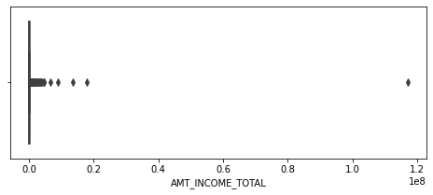
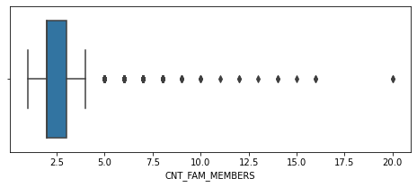
Detecting Outliers in Columns
VARIABLE: AMT_INCOME_TOTAL
AMT_INCOME_TOTAL tells us about the income of the client. It is clearly visible that the value of 1.2 is an outlier.
VARIABLE: CNT_FAM_MEMBERS
CNT_FAM_MEMBERS tells us How many family members does the client have.
From box plot, we can observe that it has detected some outliers in the data and maximum family member's count is 20, which is very rare but it cannot be considered as a outlier.

Slide 8
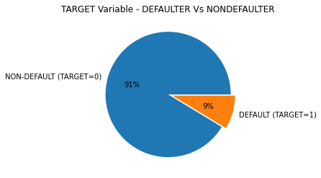
Imbalance Ration in TARGET variable
From the given pie chart, it is clear that:
There is an imbalance between people who
defaulted and who didn't default.
More than 91% of people are non-defaulters as opposed to 9% who defaulted.
Imbalance ratio for TARGET variable is 10.55.

Slide 9








Univariate Data Analysis
CATEGORICAL UNIVARIATE ANALYSIS FOR
TARGET 0 (NON-DEFAULTERS)
&
TARGET 1 (DEFAULTERS)

Slide 10

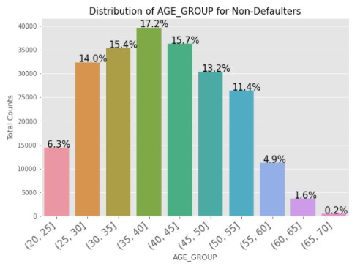


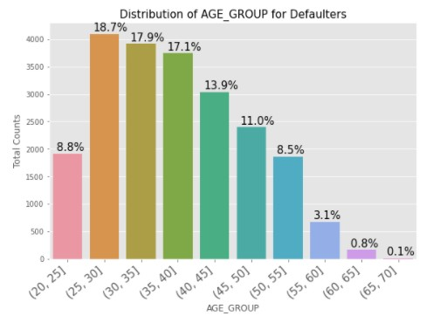



DISTRIBUTION OF AGE GROUP
From the graphs of Age_Group, we can say that:
Age-group of 35-40 has higher percentage of being a non-defaulter (around 17.2%) among the other age groups. It might be possible considering, at this age most people are well settled in their life and earning enough to pay the loan amount on time.
From the plot for target-1 data, we can see that the Age-group of 25-30 has higher percentage of becoming a defaulter (around 18.7%) as compared to other age groups.
Thus, We can observe that customers belonging to age group 30-40 are able to make payment on time and can be considered while lending loan. We can also consider age group of 40 to 55, as they contribute more to non-defaulters.

Slide 11
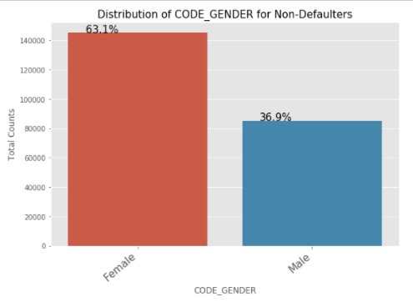
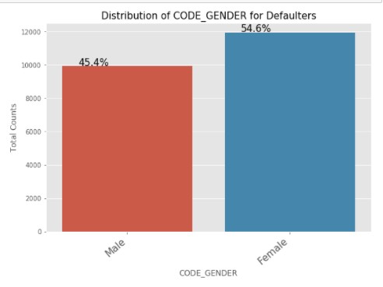
DISTRIBUTION OF CODE GENDER
From the graph, we can conclude
that:
Female contribute more to the non-defaulters as compared to the defaulters.
Number of females applying for loan than males is greater and hence the more number of female defaulters as well.
But the rate of defaulting of FEMALE is much lower compared to their MALE counterparts.

Slide 12
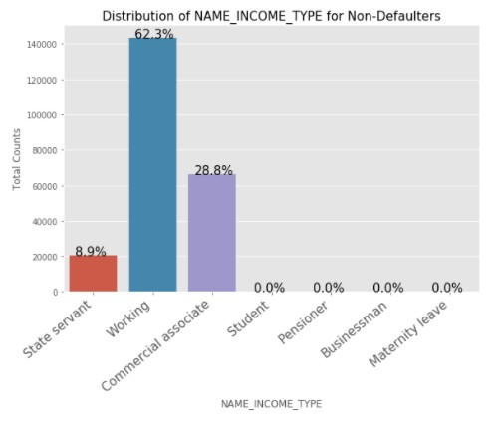

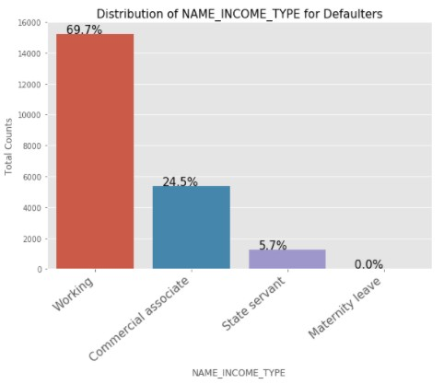
DISTRIBUTION OF NAME INCOME TYPE
From the graph, we can see that:
The students don't default. The reason could be they are not required to pay during the time they are students.
Also the Businessmen never default.
Most of the loans are distributed to working class people.
Working class people contribute less to non-defaulters as compared to the defaulters. So the chances of defaulting are more in their case.

Slide 13
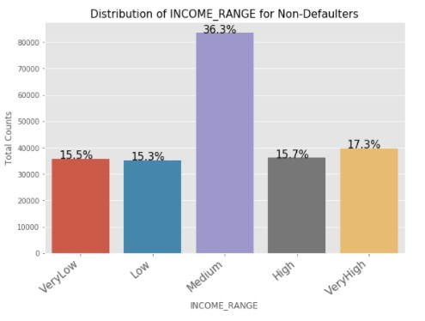
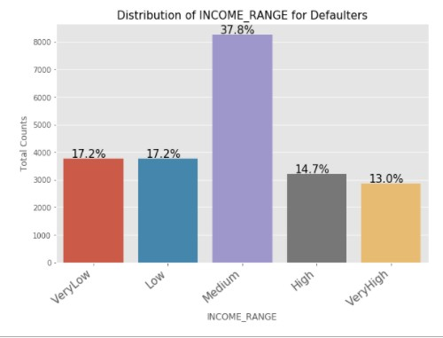
DISTRIBUTION OF INCOME RANGE
From the graph, we can see that:
Low income range has higher defaults as their proportion in defaulted population is higher than in the non defaulted population.

Slide 14
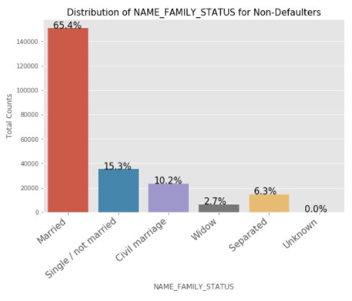
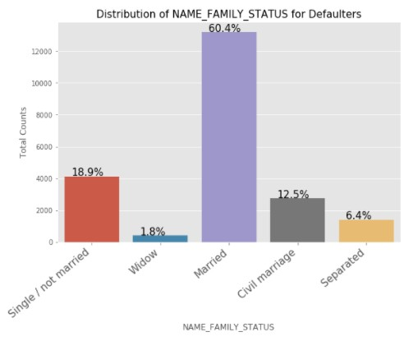
DISTRIBUTION OF NAME FAMILY STATUS
From the graph, we can see that:
Married people tend to apply for more loans as compared to others.
Single/non Married people contribute more to the Defaulters as compared to Non-Defaulters. So the chances of defaulting are more in their case.
Widow is less likely to
delay/default.

Slide 15
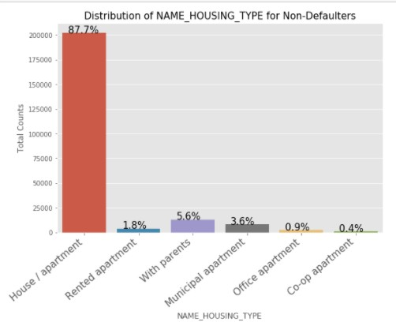
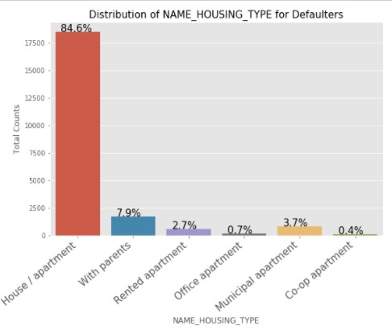
DISTRIBUTION OF NAME HOUSING TYPE
From the graph, we can see that:
People who have House/Apartment tend to apply for more loans and tend to default as well.
People living with parents tend to default more often when compared with others.

Slide 16
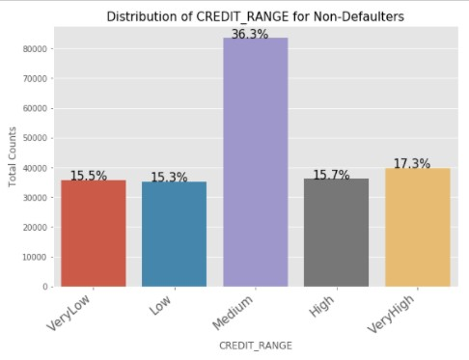
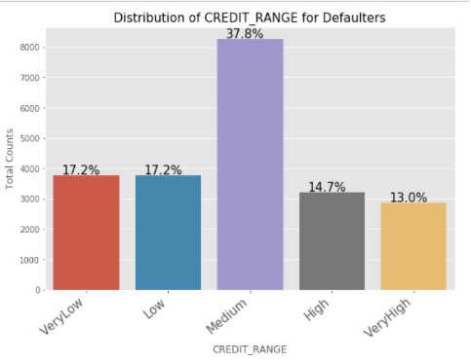
DISTRIBUTION OF CREDIT RANGE
From the plot we can say that:
Customers with less credit range and most likely to make payment considering total count.
Customers having medium and high credit can also be considered while lending the loan.
Very high value loans are less likely to be defaulted, this may be because such loans are availed by High Income Individuals.
Very low value loans are also less likely to be defaulted as the lower value makes it easier for the client to repay.

Slide 17
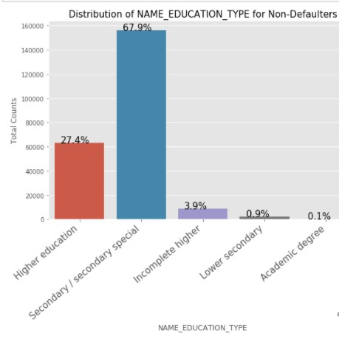
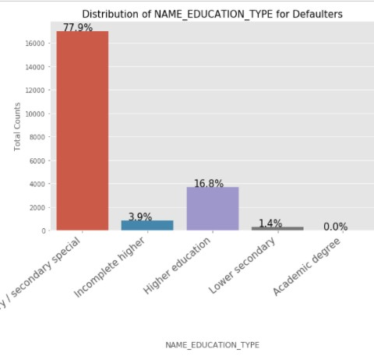
DISTRIBUTION OF NAME EDUCATION TYPE
From the graph, we can conclude
that:
There are less non-defaulters for education type 'Secondary/Secondary Special' as compared to defaulters.
Same goes for education type 'Higher Education' too. Reason can be that they are much educated and can pay the loan on time.

Slide 18
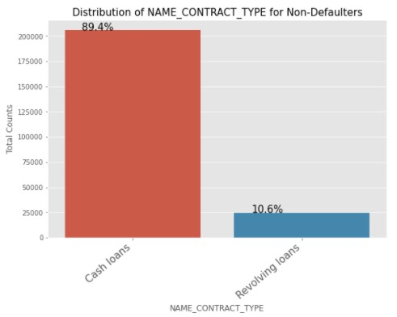
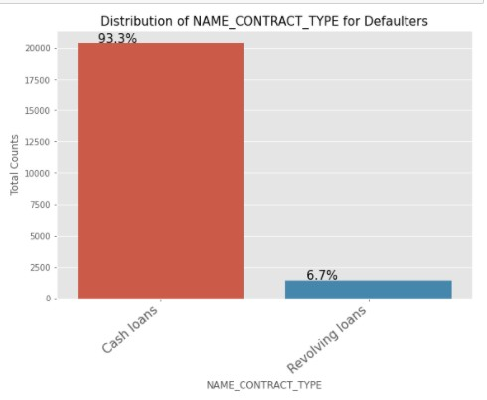
DISTRIBUTION OF NAME CONTRACT TYPE
From the graph, we can conclude
that:
As we can see number of Defaults on Revolving loans is lesser.
In a Revolving loan the borrower has the flexibility to draw down or withdraw, repay, and withdraw again. Thus, allows clients to pay on time while simultaneously being safer for the bank.
The Graphs for Cash loans are almost equal in both Defaults and Non-Defaults category, so no valuable insights can be drawn.

Slide 19
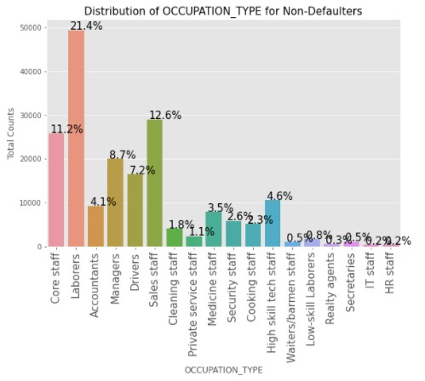
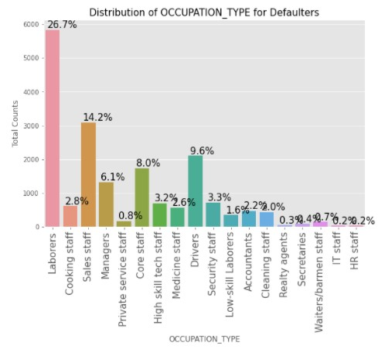
DISTRIBUTION OF OCCUPATION TYPE
From the graph, we can conclude
that:
Laborers are most likely to make payment on time as compared to other non-defaulter occupation types considering total count.
Whereas HR staff and IT staff seems to be less likely to make payment on time as compared to other occupations.

Slide 20
SEGMENTED UNIVARIATE ANALYSIS FOR
TARGET 0 (NON-DEFAULTERS)
&
TARGET 1 (DEFAULTERS)

Slide 21



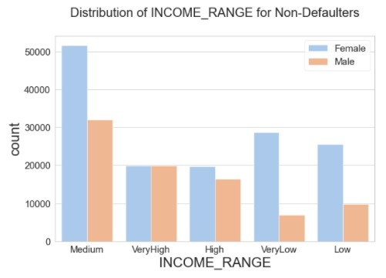
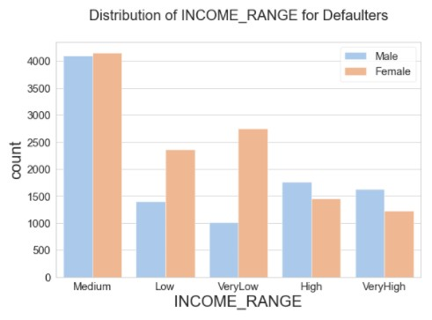



DISTRIBUTION OF INCOME RANGE & CODE GENDER
Points to be concluded from the
graph. (Target 0)
Female counts are higher than male i.e, females with variable income ranges tend to pay the amount with no difficulties and become non-defaulters
Whereas, count of males becoming non-defaulter with similar income ranges is less
Points to be concluded from the
graph. (Target 1)
Male counts are higher for higher income range.
Income group 'Medium' is having more number of male and female defaulter customer.
.

Slide 22
CONTINUOUS UNIVARIATE ANALYSIS FOR
TARGET 0 (NON-DEFAULTERS)
&
TARGET 1 (DEFAULTERS)

Slide 23
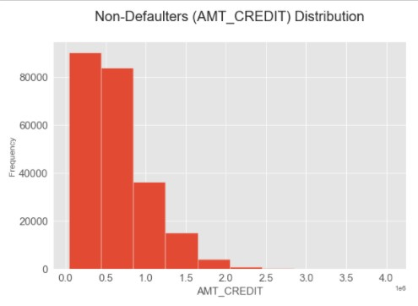
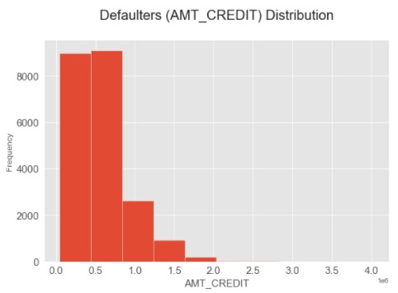
DISTRIBUTION OF AMT CREDIT
Points to be concluded from the graph on the right side.
AMT_CREDIT Defaults is highest for the 500000-1000000 range
AMT_CREDIT for non-defaulters is highest for range 0 to 500000.
Chances of people with credit range of 0 to 500000 is more for being a non-defaulter

Slide 24
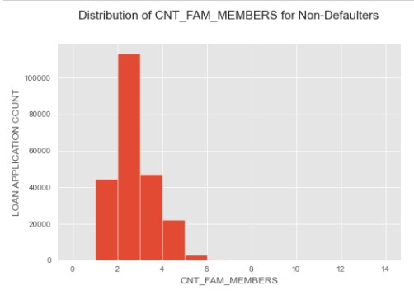
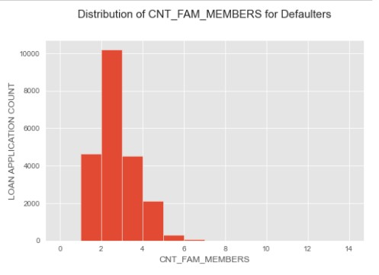
DISTRIBUTION OF CNT FAM MEMBERS
Points to be concluded from the graph on the right side.
We can see that a family of 3 applies loan more often than the other families

Slide 25
BIVARIATE DATA ANALYSIS
NUMERICAL BIVARIATE ANALYSIS FOR
TARGET 0 (NON-DEFAULTERS)
&
TARGET 1 (DEFAULTERS)

Slide 26
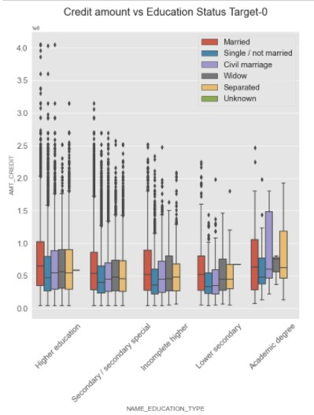
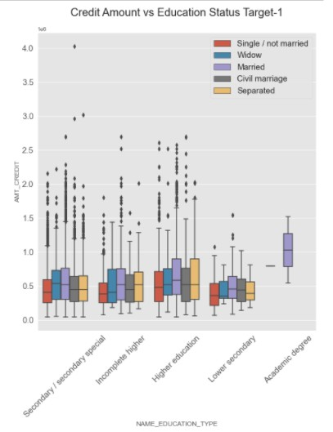
DISTRIBUTION OF CREDIT AMOUNT V/S EDUCATION STATUS – TARGET 0
Points to be concluded from the graph son the right side.
Common Inference:
We can say, single/not married people are always having less credit amount as compared to other categories.
Those with higher education have higher credits and are more likely to make payments on time.
For non-defaulters as well as defaulters data, more outliers are present in Higher education and Secondary education type.
The people with secondary and secondary special education are less likely to make payments on time.

Slide 27
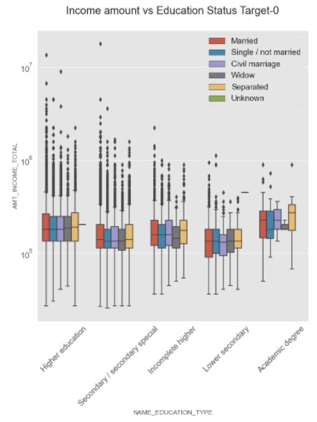
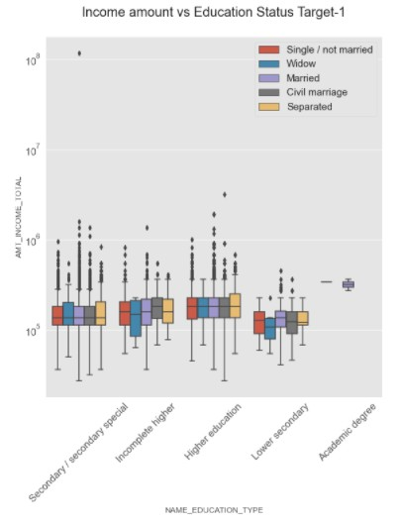
DISTRIBUTION OF INCOME AMOUNT V/S EDUCATION STATUS- TARGET 0
Points to be concluded from the graphs on the right side.
Common Inference:
Those with higher education have higher income and are more likely to make payments on time.
For non-defaulters as well as defaulters data, more outliers are present in Higher education type.
People with less income amount
tend to be defaulters.

Slide 28
CONTINUOUS BIVARIATE ANALYSIS FOR
TARGET 0 (NON-DEFAULTERS)
&
TARGET 1 (DEFAULTERS)

Slide 29
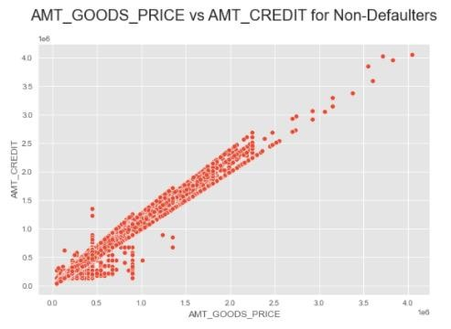
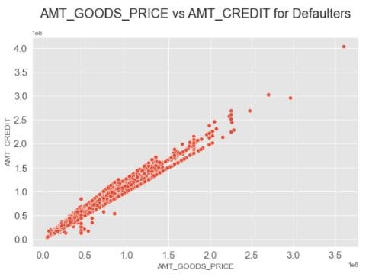
DISTRIBUTION OF AMT GOODS PRICE, AMT CREDIT
Points to be concluded from the graph on the right side.
Goods Price and Credits have a somewhat linear relationship. As the Good Price is increasing the corresponding credits also increases.
Defaults are relatively less for the values less than 500,000 for 'AMT_CREDIT' and 1,000,000 for 'AMT_GOODS_PRICE'
This increase in credits is more in case of non-defaulters data, as on time payments increases the credits.
People with loans for higher goods price and have made their payments on time thus they have higher credits.
Whereas credits are not very high for those with higher goods price but
didn’t pay loan or they are defaulters.
.

Slide 30
MULTIVARIATE ANALYSIS
FOR
TARGET 0 (NON-DEFAULTERS)
&
TARGET 1 (DEFAULTERS)

Slide 31
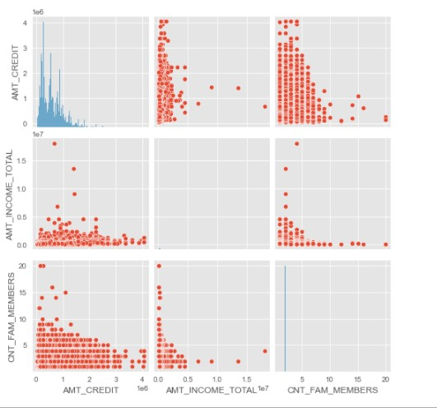
DISTRIBUTION OF AMT CREDIT, AMT INCOME TOTAL, CNT FAM MEMBERS- TARGET 0
Points to be concluded from the graph on the right side.
For non-defaulter's data, people with low or medium income and less family members more likely to pay amount on time and thus have high credits.
Larger families and people with larger AMT_CREDIT default less often.

Slide 32
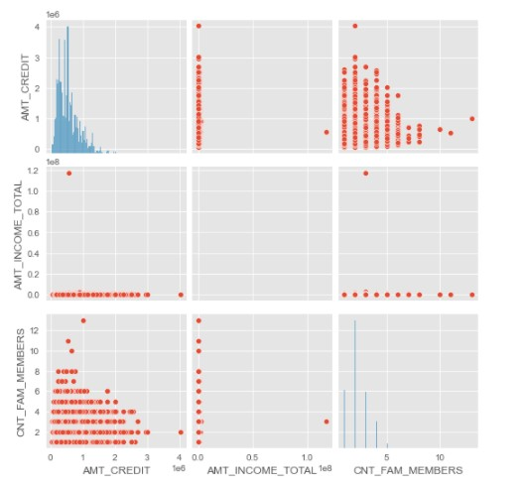
DISTRIBUTION OF AMT CREDIT, AMT INCOME TOTAL, CNT FAM MEMBERS- TARGET 1
Points to be concluded from the graph on the right side.
For defaulter's data , people with very low or low income tends to have less credits as compared to non-defaulter's data irrespective of the total family members count.
People are equally likely to default if the family is small and the AMT_CREDIT is low, considering the income is low. This can happen if the people were unable to pay the amount on time resulting in low credits or if the customers haven't paid the amount.

Slide 33
CORRELATION OF TARGET 0

Slide 34
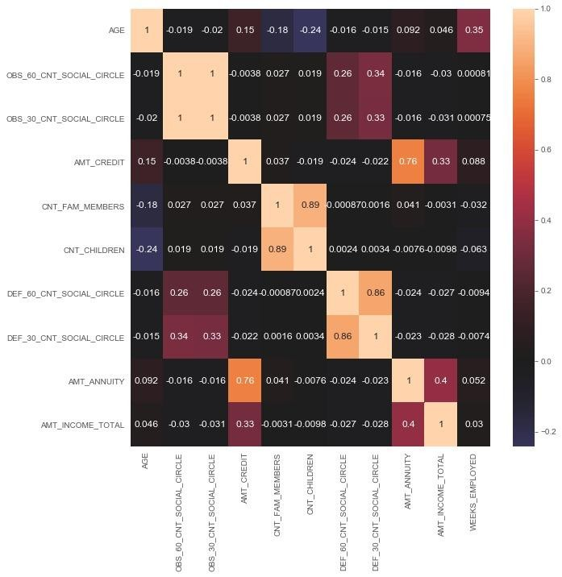

Slide 35
CORRELATION FOR TARGET 0
Points to be concluded from the graph presented before:
Columns like 'AGE', 'OBS_60_CNT_SOCIAL_CIRCLE', 'OBS_30_CNT_SOCIAL_CIRCLE', 'AMT_GOODS_PRICE', 'AMT_CREDIT' are highly correlated. Positive correlation indicates that if one variable changes, then other will also change in the same way.
There is negative correlation between 'Amt_Annuity' & 'OBS_60_CNT_SOCIAL_CIRCLE', which means that they are inversely proportional to each other.

Slide 36
CORRELATION OF TARGET 1

Slide 37
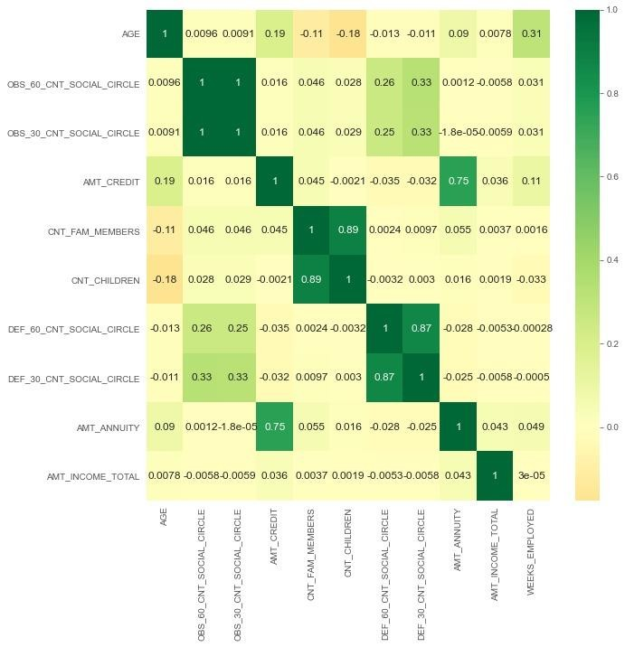

Slide 38
CORRELATION FOR TYPE 1
This heat map for Target 1 is also having quite a same observation just like Target 0. But for few points are different. They are listed below.
Columns like 'AGE', 'OBS_60_CNT_SOCIAL_CIRCLE', 'OBS_30_CNT_SOCIAL_CIRCLE', 'AMT_GOODS_PRICE', 'AMT_CREDIT' are highly correlated. Positive correlation indicates that if one variable changes, then other will also change in the same way.
There is negative correlation between 'Amt_Income_Total' & 'OBS_60_CNT_SOCIAL_CIRCLE', which means that they are inversely proportional to each other.

Slide 39
Analysis Approach – Part 2
Load Previous application Data and Application data from earlier analysis
Importing libraries and loading data files
Data inspection
Data Cleaning and manipulations on Previous Application Data
Merging the files and data inspection
Data Analysis on Merged Data
Univariate analysis of Categorical and numeric variables
Segmented univariate Analysis
Bivariate Analysis
Multivariate Analysis
Final Conclusion

Slide 40
UNIVARIATE ANALYSIS AFTER MERGING PREVIOUS DATA

Slide 41
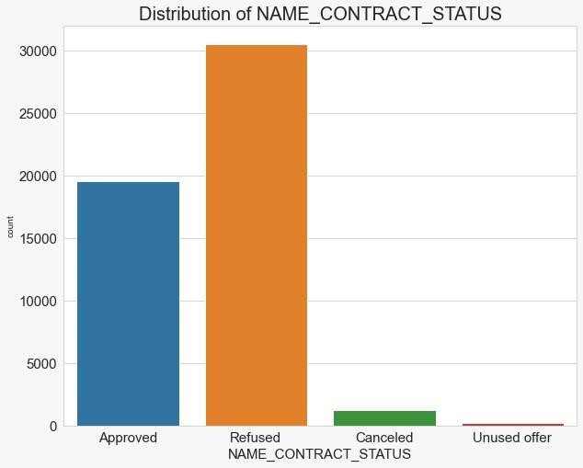
DISTRIBUTION OF NAME CONTRACT STATUS
Few points can be concluded from the graph.
Count of Refused applications is more in merged data
Unused offer have lowest count

Slide 42
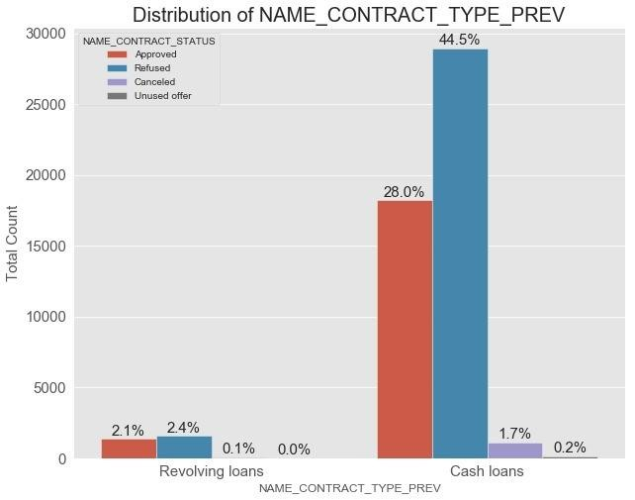
DISTRIBUTION OF NAME CONTRACT TYPE PREV
Few points can be concluded from the graph.
People with Name_Contract_Type as 'Cash Loans' have a greater percentage of Loan Refusal as compared to their Loan Approval applications.
Whereas people with Name_Contract_Type as 'Revolving Loans' do not have much difference in their Loan approval & Loan refusal applications.

Slide 43
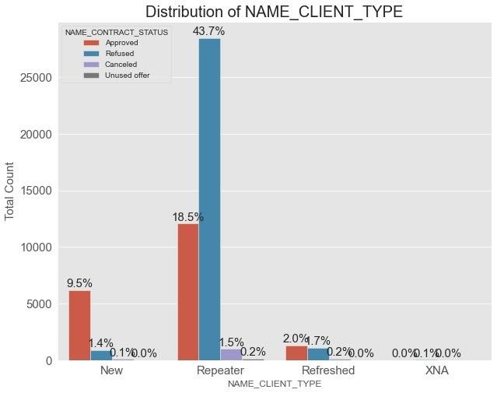
DISTRIBUTION OF NAME CLIENT TYPE
Few points can be concluded from the graph.
People who are already connected with bank, 'Repeater' have more Loan refusal applications.
Whereas 'New' members of the bank have very less Loan Refusal percentage.

Slide 44
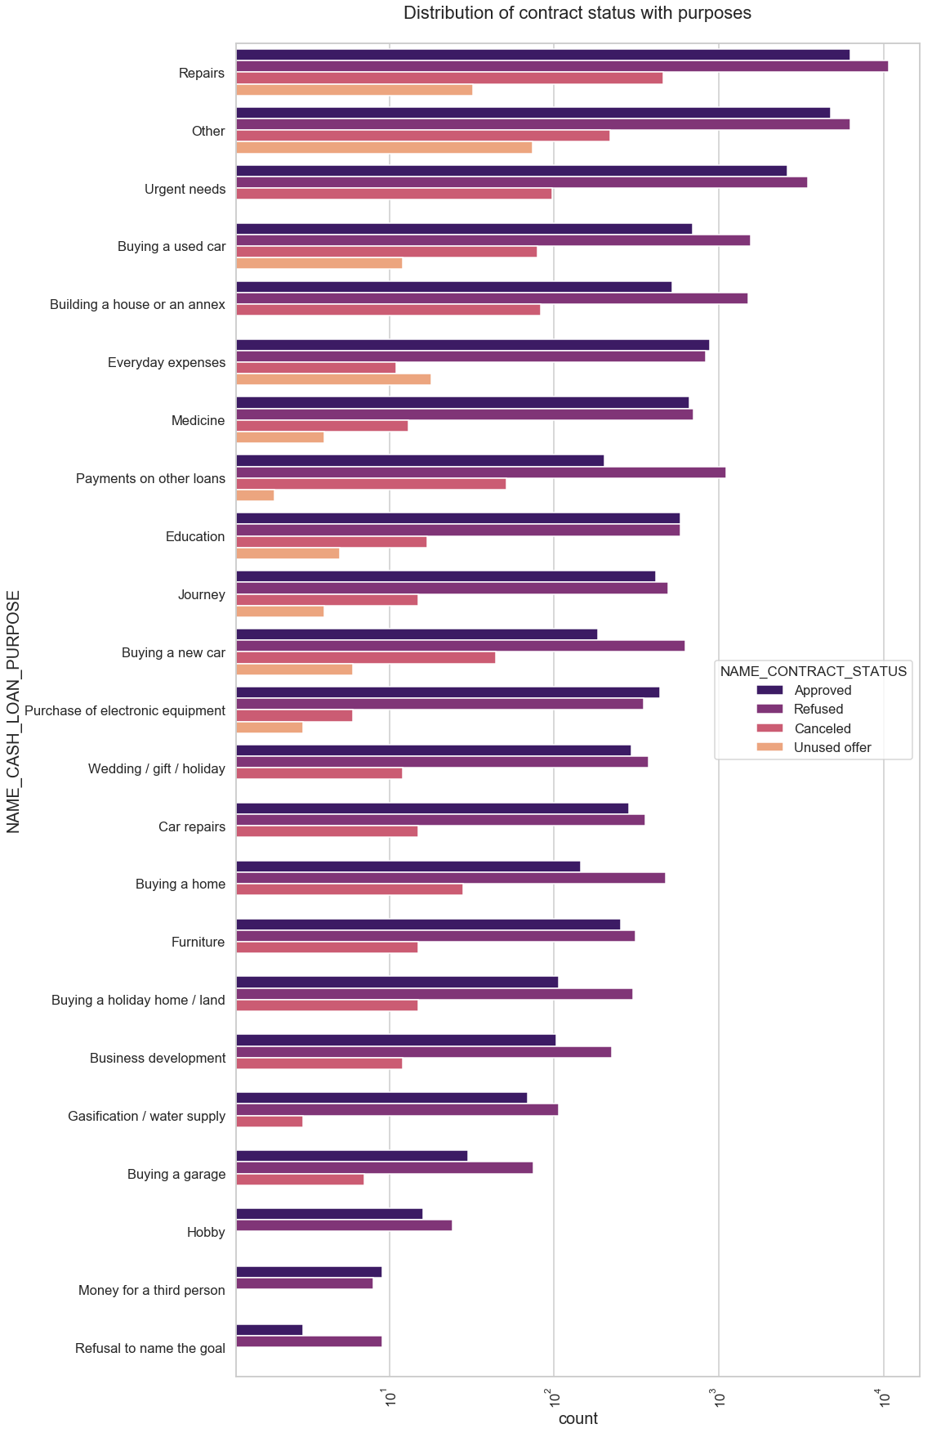
DISTRIBUTION OF CONTRACT STATUS WITH PURPOSES
Few points can be concluded from the graph.
Most rejection of loans came from purpose 'repairs'.
For education purposes we have equal number of approves and rejection
Paying other loans and buying a new car is having significant higher rejection than approves.

Slide 45
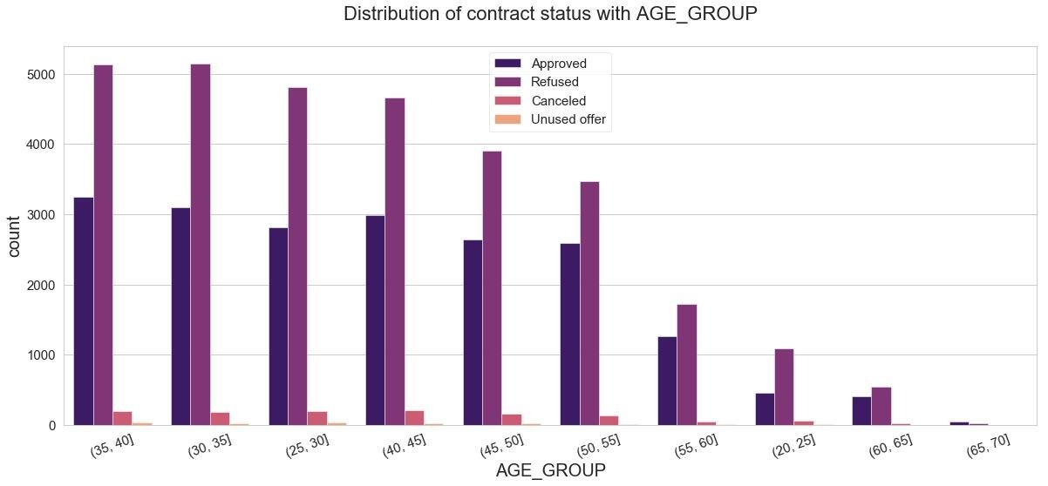
DISTRIBUTION OF CONTRACT STATUS WITH AGE GROUP
Few points can be concluded from the graph.
Customers from various AGE-GROUPS have higher count of application refusal than approval.
As we saw earlier, people in AGE GROUP of 25-30 showed higher chances of being a defaulter. Here from above plot we can see that this age- group have refusal count approx twice the approval count.
Also, 35-40 age group people were higher in non-defaulter's data. Here for the same age group we can see more than 3000 applications are approved and more than 5000 applications were refused.

Slide 46
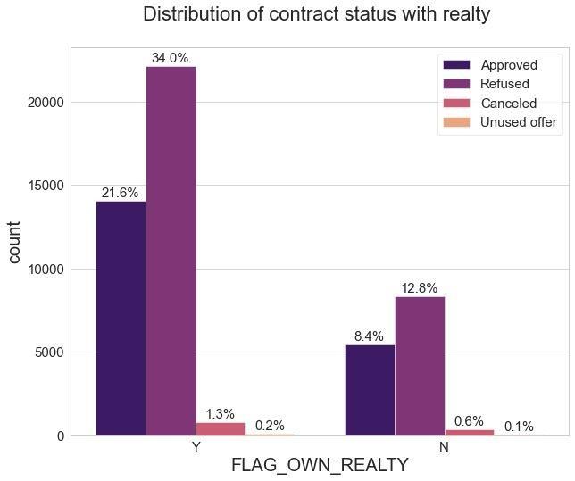
DISTRIBUTION OF CONTRACT STATUS WITH REALTY
Few points can be concluded from the graph.
Rejection of loans are higher in people who owns a house, as compared to people who don't.
But at the same time, number of loan approvals are also higher in people who owns a house. So, we can say that the people who owns a 'house' apply for more loans as compared to people who don't.

Slide 47
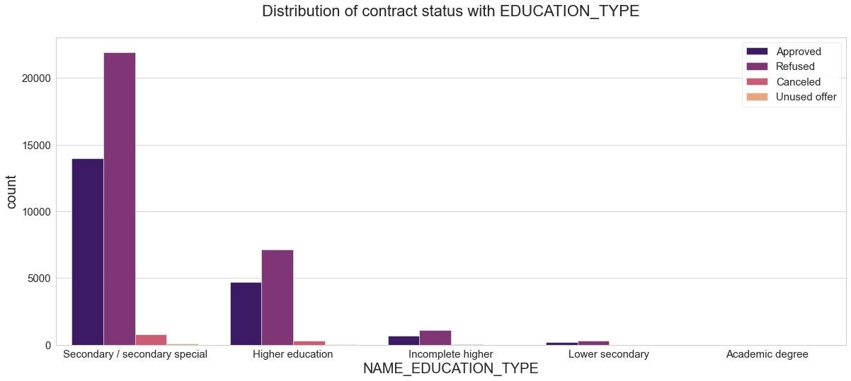
DISTRIBUTION OF CONTRACT STATUS WITH EDUCATION TYPE
Few points can be concluded from the graph.
People with 'Secondary/Secondary Special' education type tend to apply for more loans and have greater percentage of loan refusal as compared to people with 'Higher Education'.
'Incomplete Higher' & 'Lower Secondary' education type people do not apply for loans as such.

Slide 48
PERFORMING BIVARIATE ANALYSIS

Slide 49

PREV CREDIT AMOUNT VS HOUSING TYPE
Few points can be concluded from the graph.
Here for Housing type, office apartment is having higher credit of target 0 and co-op apartment is having higher credit of target 1.
So, we can conclude that bank should avoid giving loans to the housing type of co-op apartment as they are having difficulties in payment.
Bank can focus mostly on housing type with parents or House\apartment or municipal apartment for successful payments.

Slide 50
FINAL CONCLUSION
Banks should focus more on contract type ‘Student’ ,’pensioner’ and ‘Businessman’ with housing ‘type other
than ‘Co-op apartment’ for successful payments.
Clients from housing type ‘With parents’ or House/apartment or municipal apartment should be considered more as they are having least number of unsuccessful payments.
Customers belonging to age group 30-40 are able to make payment on time and can be considered while
lending loan. We can also consider age group of 40 to 55, as they contribute more to non-defaulters.
Mostly people apply through 'Cash Loans' as compared to 'Revolving Loans' and also 'Cash Loans' have less default percentage too.
Loan applications from Clients with Secondary/ Secondary special as Education type can be approved after taking into account other factors like their Income Range.
Female clients tend to pay loan amount on time, thus banks can consider them while approving loans.

Slide 51
THANK YOU!

